Slide 1
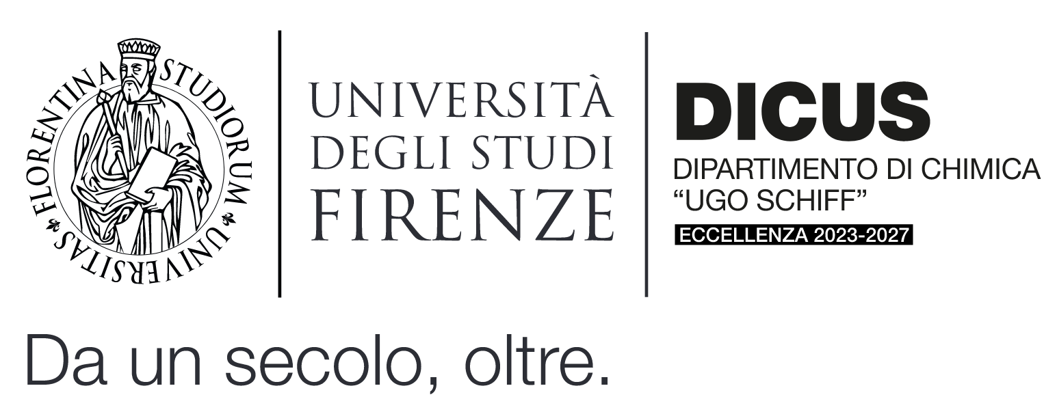
prof. dr hab. Piotr Stefanowicz
Faculty of Chemistry, University of Wroclaw, Poland
piotr.stefanowicz@uwr.edu.pl
24-28 March 2025
Advanced course in Mass Spectrometry
LECTURE TOPICS
Monday 24.03.2025 - Lesson 1, 2 – 5 pm Aula 18, Blocco Aule, via Bernardini 6, 50019 Sesto Fiorentino
a) Why does a chemist need mass spectrometry? b) Mass spectrum basic concepts c) Mass spectrometer - flow chart
Join online: https://meet.google.com/wyg-yzix-opz
Wednesday 26.03.2025 - Lesson 2, 2 – 6 pm
Aula 18, Blocco Aule, via Bernardini 6, 50019 Sesto Fiorentino
d) How are ions obtained? - Ion sources and ionisation techniques (EI, CI, APCI, ESI, MALDI)
e) Measuring m/z values, mass analysers
f) Tandem and Hybrid Mass Spectrometers g) Ion fragmentation -Types of ions formed during ionisation -How to predict ion decay -Typical fragmentation mechanisms
Join online: https://meet.google.com/wca-srnd-wyp
Prof. Dr. Anna Maria Papini Prof. Dr. Anna Maria Papini Coordinator of the PhD
in Chemical Sciences Organizer

Slide 2
prof. dr hab. Piotr Stefanowicz
Faculty of Chemistry, University of Wroclaw, Poland
piotr.stefanowicz@uwr.edu.pl
24-28 March 2025
Advanced course in Mass Spectrometry
LECTURE TOPICS
Thursday 27.03.2025 - Lesson 3, 2 – 5 pm
Aula 18, Blocco Aule, via Bernardini 6, 50019 Sesto Fiorentino
h) Interpretation of Mass Spectra. - Determining the molecular weight of the compound under investigation -High-resolution spectra, determination of the compound formula –Using fragmentation spectra for structure determination
i) Examples and exercises
Join online: https://meet.google.com/rch-figw-bdm
Friday 28.03.2025 - Lesson 4 and final exam, 14 – 16 am
Aula 01 Tendostruttura, 50019 Sesto Fiorentino
l) Examples and exercises. Final exam.
Join online: https://meet.google.com/iuv-hwqx-xhz
Prof. Dr. Anna Maria Papini Prof. Dr. Anna Maria Papini Coordinator of the PhD
in Chemical Sciences Organizer

Slide 3
prof. dr hab. Piotr Stefanowicz
Faculty of Chemistry, University of Wroclaw, Poland
piotr.stefanowicz@uwr.edu.pl
24-28 March 2025
Advanced course in Mass Spectrometry
Course program and objectives
Understand the Role of Mass Spectrometry – Explain why mass spectrometry is essential in chemical analysis. Learn Basic Concepts of Mass Spectra – Define key terms like m/z ratio, isotopic patterns, and peak interpretation. Describe the Mass Spectrometer Workflow – Understand the components and functioning of a mass spectrometer. Explore Ionization Techniques – Compare different ionization methods (EI, CI, APCI, ESI, MALDI) and their applications. Analyze Mass Measurement Techniques – Learn how different mass analyzers determine m/z values. Understand Tandem and Hybrid MS – Explain their advantages in complex analyses. Study Ion Fragmentation Patterns – Identify types of ions, predict ion decay, and understand fragmentation mechanisms. Interpret Mass Spectra – Determine molecular weight, molecular formula, and structural information from spectra. Apply Knowledge to Practical Examples – Solve exercises to reinforce understanding of mass spectrometry principles.
Prof. Dr. Anna Maria Papini Prof. Dr. Anna Maria Papini Coordinator of the PhD
in Chemical Sciences Organizer

